Slide 1
Quality Management
Compiled by:
Ravi Prakash Shahi

Slide 2
Quality Management
Managing the quality of the software process and products

Slide 3
Objectives
To introduce the quality management process and key quality management activities
To explain the role of standards in quality management
To explain the concept of a software metric, predictor metrics and control metrics
To explain how measurement may be used in assessing software quality

Slide 4
Software quality management
Concerned with ensuring that the required level of quality is achieved in a software product
Involves defining appropriate quality standards and procedures and ensuring that these are followed
Should aim to develop a ‘quality culture’ where quality is seen as everyone’s responsibility

Slide 5
What is quality?
Quality, simplistically, means that a product should meet its specification
This is problematical for software systems
  Tension between customer quality requirements (efficiency, reliability, etc.) and developer quality requirements (maintainability, reusability, etc.)
  Some quality requirements are difficult to specify in an unambiguous way
  Software specifications are usually incomplete and often inconsistent

Slide 6
The quality compromise
We cannot wait for specifications to improve before paying attention to quality management
Must put procedures into place to improve quality in spite of imperfect specification
Quality management is therefore not just concerned with reducing defects but also with other product qualities

Slide 7
Quality management activities
Quality assurance
  Establish organisational procedures and standards for quality
Quality planning
  Select applicable procedures and standards for a particular project and modify these as required
Quality control
  Ensure that procedures and standards are followed by the software development team
Quality management should be separate from project management to ensure independence

Slide 8
Capability Maturity Model Integration(CMMI)

Slide 9
Capability Maturity Model Integration
(SW-CMMI)
Not a software life cycle model.
Instead it is a strategy for improving the software process, irrespective of the actual life cycle model used.
Developed in 1987 by the Software Engineering Institute (SEI) at Carnegie-Mellon University under the sponsorship of DARPA
Described in the book Managing the Software Process in 1989 by Watts Humphrey
Published as a separate document: Capability Maturity Model for Software in 1991

Slide 10
Immature Software Organizations
Software processes are generally improvised
If a process is specified, it is not rigorously followed or enforced
The software organization is reactionary
Managers only focus on solving immediate (crisis) problems
Schedules and budgets are routinely exceeded because they are not based on realistic estimates
When hard deadlines are imposed, product functionality and quality are often compromised
There is no basis for judging process quality or for solving product or process problems
Activities such as reviews and testing are curtailed or eliminated when projects fall behind schedule

Slide 11
What is CMM?
Describes an evolutionary improvement path for software organizations from an ad hoc, immature process to a mature, disciplined one.
Provides guidance on how to gain control of processes for developing and maintaining software and how to evolve toward a culture of software engineering and management excellence.

Slide 12
Process Maturity Concepts
Software Process
  set of activities, methods, practices, and transformations that people use to develop and maintain software and the associated products (e.g., project plans, design documents, code, test cases, user manuals)
Software Process Capability
  describes the range of expected results that can be achieved by following a software process
  means of predicting the most likely outcomes to be expected from the next software project the organization undertakes

Slide 13
Process Maturity Concepts
Software Process Performance
  actual results achieved by following a software process
Software Process Maturity
  extent to which a specific process is explicitly defined, managed, measured, controlled and effective
  implies potential growth in capability
  indicates richness of process and consistency with which it is applied in projects throughout the organization

Slide 14
What are the CMM Levels?
(The five levels of software process maturity)
Maturity level indicates level of process capability:
Initial
Repeatable
Defined
Managed
Optimizing

Slide 15
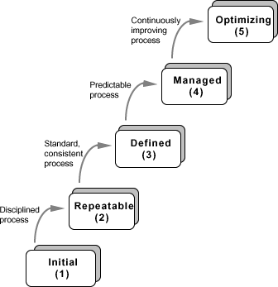
Five Levels of Software Process Maturity

Slide 16
Level 1: Initial
Initial : The software process is characterized as ad hoc, and occasionally even chaotic. Few processes are defined, and success depends on individual effort.
  At this level, frequently have difficulty making commitments that the staff can meet with an orderly process
  Products developed are often over budget and schedule
  Wide variations in cost, schedule, functionality and quality targets
  Capability is a characteristic of the individuals, not of the organization

Slide 17
Level 2: Repeatable
Basic process management processes are established to track cost, schedule, and functionality. The necessary process discipline is in place to repeat earlier successes on projects with similar applications.
  Realistic project commitments based on results observed on previous projects
  Software project standards are defined and faithfully followed
  Processes may differ between projects
  Process is disciplined
  earlier successes can be repeated

Slide 18
Level 3: Defined
The software process for both management and engineering activities is documented, standardized, and integrated into a standard software process for the organization. All projects use an approved, tailored version of the organization’s standard software process for developing an maintaining software.

Slide 19
Level 4: Managed
Detailed measures of the software process and product quality are collected. Both the software process and products are quantitatively understood and controlled.
  Narrowing the variation in process performance to fall within acceptable quantitative bounds
  When known limits are exceeded, corrective action can be taken
  Quantifiable and predictable
    predict trends in process and product quality

Slide 20
Level 5: Optimizing
Continuous process improvement is enabled by quantitative feedback from the process and from piloting innovative ideas and technologies.
Goal is to prevent the occurrence of defects
  Causal analysis
Data on process effectiveness used for cost benefit analysis of new technologies and proposed process changes

Slide 21
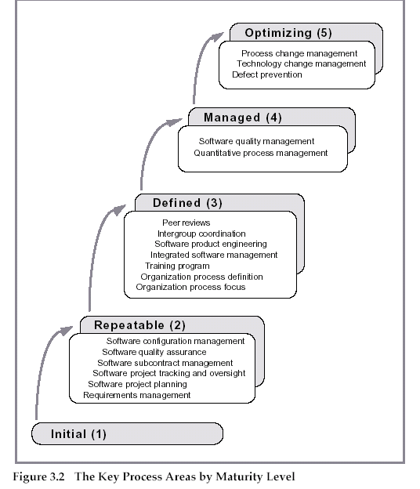
Key Process Areas in CMM

Slide 22
SEI CMM Focus and KPAs
CMM Level | Focus | Key Process Areas(KPAs)
Initial | Competent People | -
Repeatable | Project Management | a) Software project planning b) Software configuration management
Defined | Definition of Processes | a) Process definition b) Training program c) Peer reviews
Managed | Product and Process Quality | a) Quantitative process metrics b) Software quality management
Optimizing | Continuous Process Improvement | Defect prevention Process change management Technology change management

Slide 23
Characteristics of Each Level
Level 0 : Incomplete
  The process area (e.g requirements management ) is either not performed or does not achieve all goals
Initial Level (Level 1)
  Characterized as ad hoc, and occasionally even chaotic
  Few processes are defined, and success depends on individual effort
Repeatable (Level 2)
  Basic project management processes are established to track cost, schedule, and functionality
  The necessary process discipline is in place to repeat earlier successes on projects with similar applications

Slide 24
Characteristics of Each Level (continued)
Defined (Level 3)
  The software process for both management and engineering activities is documented, standardized, and integrated into a standard software process for the organization
  All projects use an approved, tailored version of the organization's standard software process for developing and maintaining software
Managed (Level 4)
  Detailed measures of the software process and product quality are collected
  Both the software process and products are quantitatively understood and controlled

Slide 25
Characteristics of Each Level (continued)
Optimized (Level 5)
  Continuous process improvement is enabled by quantitative feedback from the process and from piloting innovative ideas and technologies

Slide 26
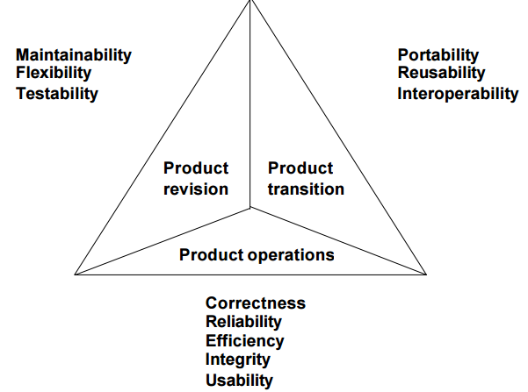
McCall’s Quality Factors

Slide 27
Internal Structure to Maturity Levels
Except for level 1, each level is decomposed into key process areas (KPA)
Each KPA identifies a cluster of related activities that, when performed collectively, achieve a set of goals considered important for enhancing software capability.
  commitment
  ability
  activity
  measurement
  verification

Slide 28
ISO 9000
International set of standards for quality management
Applicable to a range of organisations from manufacturing to service industries
ISO 9000 specifies a set of guidelines for repeatable and high quality product development
ISO 9001 applicable to organisations which are engaged in design, development, production and servicing of goods. This is the standard that is applicable to most software development organizations.
ISO 9002 standard applies to those organizations which do not design products but are only involved in production. Examples of this category of industries include steel and car manufacturing industries who buy the product and pant designs from external sources and are involved in only manufacturing those products.
ISO 9003 standard applies to organizations involved only in installation and testing of the products.

Slide 29
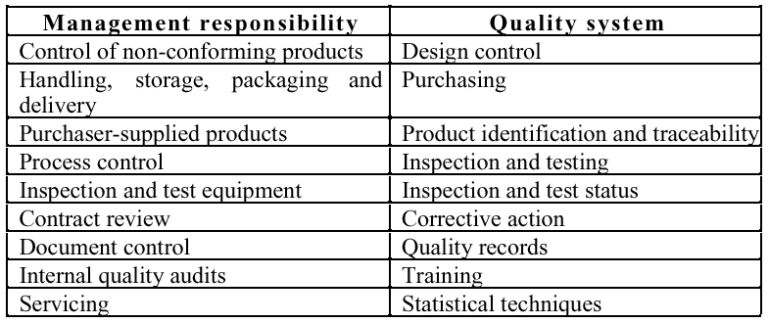
ISO 9001

Slide 30
ISO 9000 certification
Quality standards and procedures should be documented in an organisational quality manual
External body may certify that an organisation’s quality manual conforms to ISO 9000 standards
Customers are, increasingly, demanding that suppliers are ISO 9000 certified

Slide 31
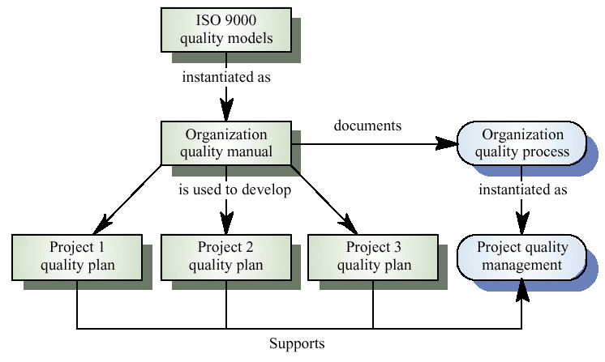
ISO 9000 and quality management

Slide 32
Quality assurance and standards
Standards are the key to effective quality management
They may be international, national, organizational or project standards
Product standards define characteristics that all components should exhibit e.g. a common programming style
Process standards define how the software process should be enacted

Slide 33
Importance of standards
Encapsulation of best practice- avoids
repetition of past mistakes
Framework for quality assurance process - it involves checking standard compliance
Provide continuity - new staff can understand
the organisation by understand the standards
applied

Slide 34
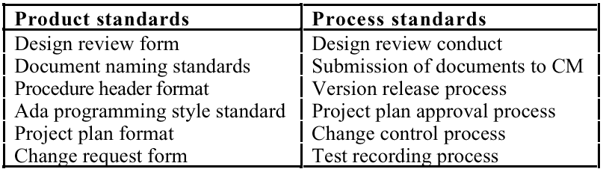
Product and process standards

Slide 35
Problems with standards
Not seen as relevant and up-to-date by software engineers
Involve too much bureaucratic form filling
Unsupported by software tools so tedious manual work is involved to maintain standards

Slide 36
Standards development
Involve practitioners in development. Engineers should understand the rationale underlying a standard
Review standards and their usage regularly.
Standards can quickly become outdated and this reduces their credibility amongst practitioners
Detailed standards should have associated tool
support. Excessive clerical work is the most
significant complaint against standards

Slide 37
Documentation standards
Particularly important - documents are the tangible manifestation of the software
Documentation process standards
  How documents should be developed, validated and maintained
Document standards
  Concerned with document contents, structure, and appearance
Document interchange standards
  How documents are stored and interchanged between different documentation systems

Slide 38
Document standards
Document identification standards
  How documents are uniquely identified
Document structure standards
  Standard structure for project documents
Document presentation standards
  Define fonts and styles, use of logos, etc.
Document update standards
  Define how changes from previous versions are reflected in a document

Slide 39
Process and product quality
The quality of a developed product is influenced by the quality of the production process
Particularly important in software development as some product quality attributes are hard to assess
However, there is a very complex and poorly understood between software processes and product quality

Slide 40
Process-based quality
Straightforward link between process and product in manufactured goods
More complex for software because:
  The application of individual skills and experience is particularly imporant in software development
  External factors such as the novelty of an application or the need for an accelerated development schedule may impair product quality
Care must be taken not to impose inappropriate process standards

Slide 41
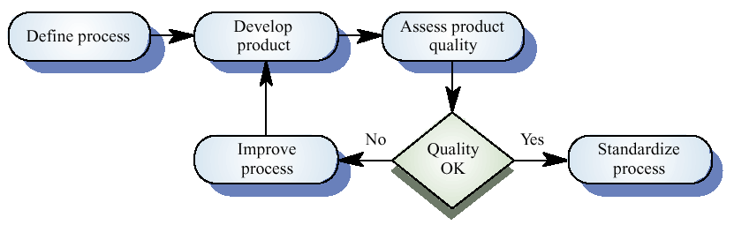
Process-based quality

Slide 42
Practical process quality
Define process standards such as how reviews
should be conducted, configuration
management, etc.
Monitor the development process to ensure
that standards are being followed
Report on the process to project management
and software procurer

Slide 43
Quality planning
A quality plan sets out the desired product qualities and how these are assessed ande define the most significant quality attributes
It should define the quality assessment process
It should set out which organisational standards should be applied and, if necessary, define new standards

Slide 44
Quality plan structure
Product introduction
Product plans
Process descriptions
Quality goals
Risks and risk management
Quality plans should be short, succinct documents
  If they are too long, no-one will read them

Slide 45
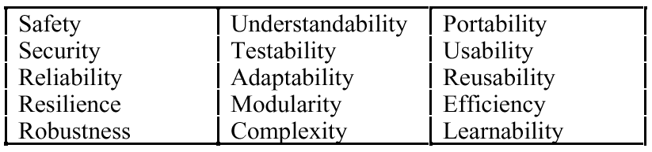
Software quality attributes

Slide 46
Quality control
Checking the software development process to ensure that procedures and standards are being followed
Two approaches to quality control
  Quality reviews
  Automated software assessment and software measurement

Slide 47
Quality reviews
The principal method of validating the quality of a process or of a product
Group examined part or all of a process or system and its documentation to find potential problems
There are different types of review with different objectives
  Inspections for defect removal (product)
  Reviews for progress assessment(product and process)
  Quality reviews (product and standards)

Slide 48
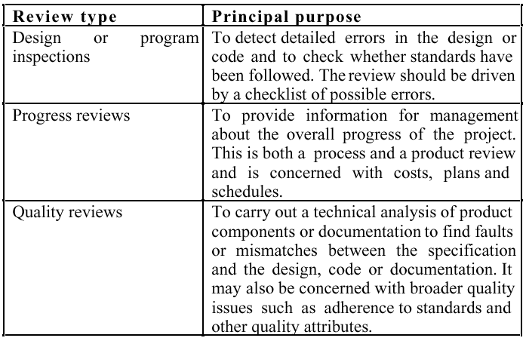
Types of review

Slide 49
Quality reviews
A group of people carefully examine part or all
of a software system and its associated
documentation.
Code, designs, specifications, test plans,
standards, etc. can all be reviewed.
Software or documents may be 'signed off' at a
review which signifies that progress to the next
development stage has been approved by
management.

Slide 50
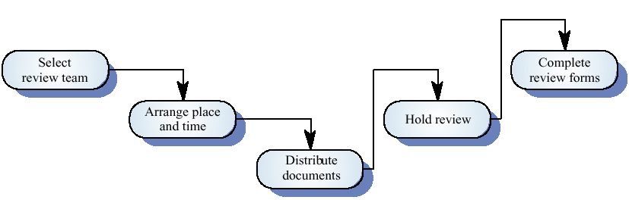
The review process

Slide 51
Review functions
Quality function - they are part of the general quality management process
Project management function - they provide information for project managers
Training and communication function - product knowledge is passed between development team members

Slide 52
Quality reviews
Objective is the discovery of system defects and inconsistencies
Any documents produced in the process may be reviewed
Review teams should be relatively small and reviews should be fairly short
Review should be recorded and records maintained

Slide 53
Review results
Comments made during the review should be
classified.
  No action. No change to the software or documentation is
  required.
  Refer for repair. Designer or programmer should correct an
  identified fault.
  Reconsider overall design. The problem identified in the
  review impacts other parts of the design. Some overall
  judgement must be made about the most cost-effective way
  of solving the problem.
Requirements and specification errors may
have to be referred to the client.

Slide 54
Software measurement and metrics
Software measurement is concerned with deriving a numeric value for an attribute of a software product or process
This allows for objective comparisons between techniques and processes
Although some companies have introduced measurment programmes, the systematic use of measurement is still uncommon
There are few standards in this area

Slide 55
Software metric
Any type of measurement which relates to a software system, process or related documentation
  Lines of code in a program, the Fog index, number of person-days required to develop a component
Allow the software and the software process to
be quantified
Measures of the software process or product
May be used to predict product attributes or to control the software process

Slide 56
Metrics assumptions
A software property can be measured
The relationship exists between what we can
measure and what we want to know
This relationship has been formalized and
validated
It may be difficult to relate what can be measured to desirable quality attributes

Slide 57
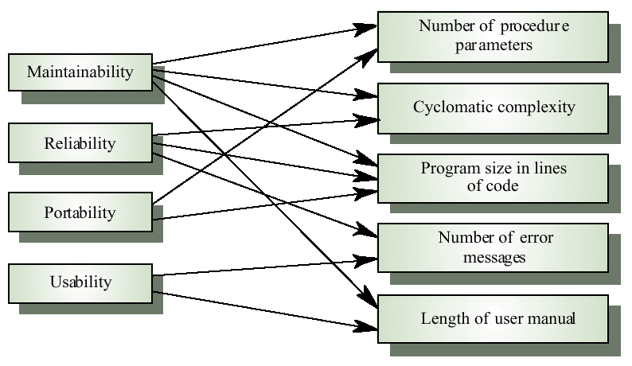
Internal and external attributes

Slide 58
The measurement process
A software measurement process may be part of a quality control process
Data collected during this process should be maintained as an organisational resource
Once a measurement database has been established, comparisons across projects become possible

Slide 59
Product metrics
A quality metric should be a predictor of
product quality
Classes of product metric
  Dynamic metrics which are collected by measurements made of a program in execution
  Static metrics which are collected by measurements made of the system representations
  Dynamic metrics help assess efficiency and reliability; static metrics help assess complexity, understandability and maintainability

Slide 60
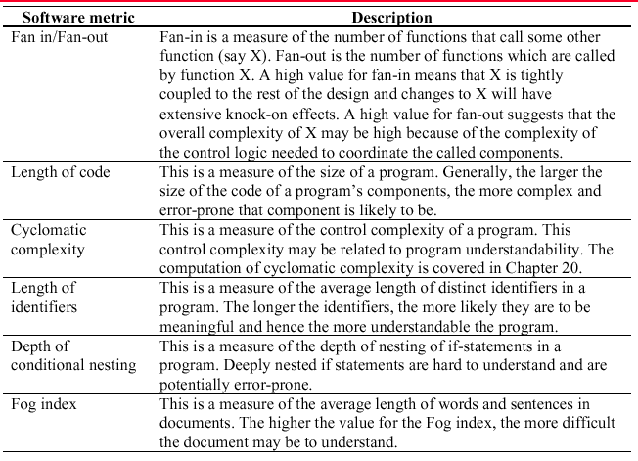
Software product metrics

Slide 61
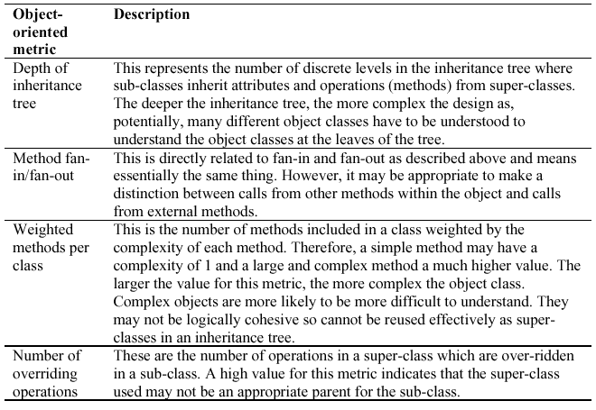
Object-oriented metrics

Slide 62
Measurement analysis
It is not always obvious what data means
  Analysing collected data is very difficult
Professional statisticians should be consulted if available
Data analysis must take local circumstances into account

Slide 63
Key points
Software quality management is concerned with ensuring that software meets its required standards
Quality assurance procedures should be documented in an organisational quality manual
Software standards are an encapsulation of best practice
Reviews are the most widely used approach for assessing software quality

Slide 64
Key points
Software measurement gathers information about both the software process and the software product
Product quality metrics should be used to identify potentially problematical components
There are no standardised and universally applicable software metrics

